Slide 1
Introduction to Software Testing: Mutation Testing
SWE 637 Wing Lam
George Mason University
Slides adapted from Lingming Zhang
https://lingming.cs.illinois.edu

Slide 2
Agenda
Quiz 9
Questions for Assignment 6
https://cs.gmu.edu/~winglam/classes/637/assigns/assign06.html
Assignment 6 is due tonight BEFORE 11:59PM
Go over optional take-home final
https://cs.gmu.edu/~winglam/classes/637/final/take-home-final.html
If you are concerned about your grades, I highly encourage you to spend time on the optional take-home final
Wrap up lecture on Chapter 9.1.2 Mutation Testing
15min break
Play CodeDefenders
https://code-defenders.org
Pass back quiz retakes
NO class next week -- Enjoy your Fall break!

Slide 3
In-class exercise: Optional take-home final Q&A
Can I answer only some questions and not all questions on the take-home final? (E.g., answering Question 1 but not Question 2)
Can I answer only some parts of a question and not all parts of a question? (E.g., answering Question 1A but not Question 1B)
When is the the take-home final due?
Will late submissions for the take-home final be graded?
Can we work as a group for the take-home final?
Should I turn in my answers to all questions even if I am unsure of my answers for some questions?
What should I do if I discussed with a friend or searched online for some parts of my take-home final?
How would the take-home final affect your total grade if the in-class final is also worth 100 points?
You do ALL questions on the take-home final and get ALL questions correct?
You do ALL questions on the take-home final and get ALL questions incorrect?
You do not do any questions on the take-home final?

Slide 4
In-class exercise: Optional take-home final Q&A
Can I answer only some questions and not all questions on the take-home final? (E.g., answering Question 1 but not Question 2)
Can I answer only some parts of a question and not all parts of a question? (E.g., answering Question 1A but not Question 1B)
When is the the take-home final due?
Will late submissions for the take-home final be graded?
Can we work as a group for the take-home final?
Should I turn in my answers to all questions even if I am unsure of my answers for some questions?
What should I do if I discussed with a friend or searched online for some parts of my take-home final?
How would the take-home final affect your total grade if the in-class final is also worth 100 points?
You do ALL questions on the take-home final and get ALL questions correct?
You do ALL questions on the take-home final and get ALL questions incorrect?
You do not do any questions on the take-home final?
Yes.
No.
BEFORE 11:59pm on December 1st, 2023.
No.
No, you may help each other but do NOT copy answers!
No, turn in only the answers that you are comfortable with!
Include for each question, who you discussed with and what you discussed.
15% of total is obtained; in-class worth 15%
0% of total is obtained; in-class worth 15%
0% of total is obtained; in-class worth 30%

Slide 5
Agenda
Quiz 9
Questions for Assignment 6
https://cs.gmu.edu/~winglam/classes/637/assigns/assign06.html
Assignment 6 is due tonight BEFORE 11:59PM
Go over optional take-home final
https://cs.gmu.edu/~winglam/classes/637/final/take-home-final.html
If you are concerned about your grades, I highly encourage you to spend time on the optional take-home final
Wrap up lecture on Chapter 9.1.2 Mutation Testing
15min break
Play CodeDefenders
https://code-defenders.org
Pass back quiz retakes
NO class next week -- Enjoy your Fall break!

Slide 6
Kill a Mutant
Reachability
Execute the mutated statement
Necessity
Make a program internal state change
Sufficiency
Propagate the change to output

Slide 7
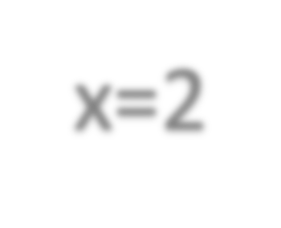

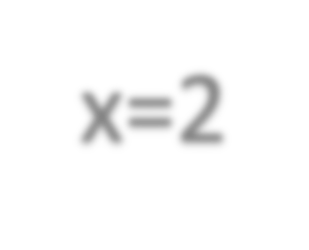


Kill a Mutant: example
read x
if (x>0)
x=x+1; if(x<4)
x=1;
return x;
read x
if (x>0)
x=1+1;
if(x<4) x=1;
return x;
x=2
x=2
Value Replacement
tests | reachability | necessity | sufficiency | killed?
0 |  |  |  | N (1=1)
1 |  |  |  | N (1=1)

Slide 8

Kill a Mutant: example
read x
if (x>0)
x=x+1; if(x<4)
x=1;
return x;
read x
if (x>0)
x=1+1;
if(x<4) x=1;
return x;
x=3
x=3
Value Replacement
tests
reachability
necessity
sufficiency
killed?
0
N (1=1)
1
N (1=1)
2
N (1=1)
3
Y (4!=1)

Slide 9
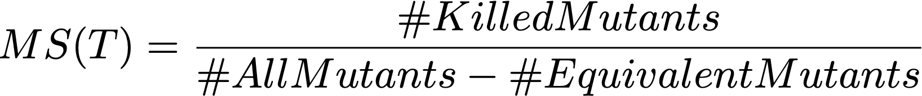
Mutation Testing criteria
Test suite T kills a mutant m, iff there exist a test t in T kills m
The effectiveness of test suites can be measured using mutation score
(similar to code coverage metric):

Slide 10
In-class exercise
What is mutation testing?
Why is it useful?
What are the three steps to do mutation testing?

Slide 11
Summary of Mutation Testing
A fault-based methodology for evaluating tests [Hamlet1977, DeMillo+1978]
Step-1: Applies artificial changes based on mutation operators to generate mutants (each mutant with only one artificial bug)
Step-2: Runs the test suite against each mutant
If any test fails (i.e., mutant’s output != original output), the mutant is killed
If all tests pass, the mutant survives
Step-3: Computes the mutation score: the higher, the better

Slide 12
This class
Mutation Testing
Basic idea
Detailed Approach
Limitation and solutions
Do fewer
Do faster
Do smarter
State of the art tools

Slide 13
Limitation of Mutation Testing
Mutation testing is extremely costly, since we need to run the test suite against each mutant
Using 108 mutation operators, Proteum generates 4,937 mutants for tcas
(only 137 lines): 4937 times slowdown (without any optimization)
State-of-the-art PIT mutation tool (with many optimizations) on 11 OSS:
2250
2025
1800
1575
1350
1125
900
675
450
225
0
2000X
Slowdown (X)
200X
JDepend
JTopas
Barbecue
Mime4J
Jaxen
XStream
Xml-Sec
Com-Lang
Joda-Time
JMeter
Time&Mon ey

Slide 14
Optimization techniques
Do fewer (fewer mutants)
Selective mutation
Do smarter
Weak mutation
Do faster
Schema-based analysis, specific compilation, parallel execution

Slide 15
Do fewer
Selective mutation testing: select a subset of mutants to do mutation testing
If a test suite can kill mutants in the subset, then it has a high probability to kill all mutants
How to select?
Operator-based mutant selection
Random mutant selection

Slide 16
Operator-based mutant selection
Only use mutants generated by a subset of mutation operators
Wong and Mathur [Wong+95] investigated selection of two mutation operators among all the 22 mutation operators in Fortran
Offutt et al. [Offutt+96] then proposed five mutation operators, named sufficient mutation operators
99% rule: the test suite that kills all selected mutants should kill >99% of all mutants

Slide 17
Random mutant selection
Randomly select x% mutants from all mutants

Slide 18
Which is better?
Operator-based mutant selection is not better than random mutant selection when they select the same number of mutants [Zhang+10]

Slide 19
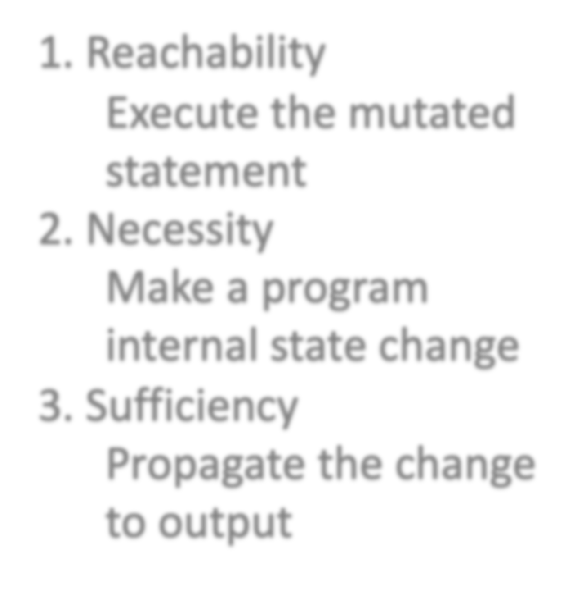

Do smarter
How to kill a mutant?
Weak mutation testing
Only check the reachability and necessity conditions
A mutant is deemed as weakly killed
as long as it cause internal state change
Pro: more efficient, do not need to execute each mutant completely
Con: imprecise, weakly killed mutants may not be actually killed
Reachability
Execute the mutated statement
Necessity
Make a program internal state change
Sufficiency
Propagate the change to output

Slide 20


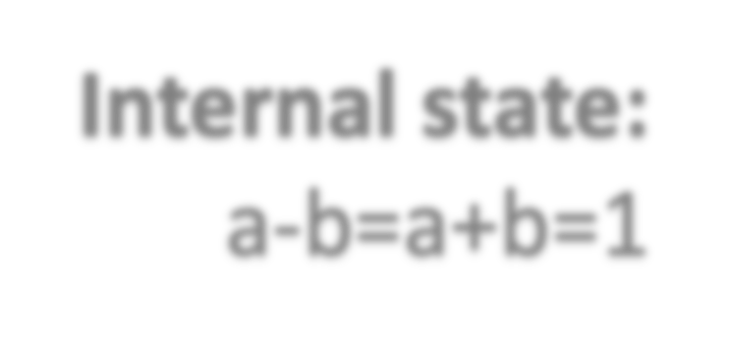


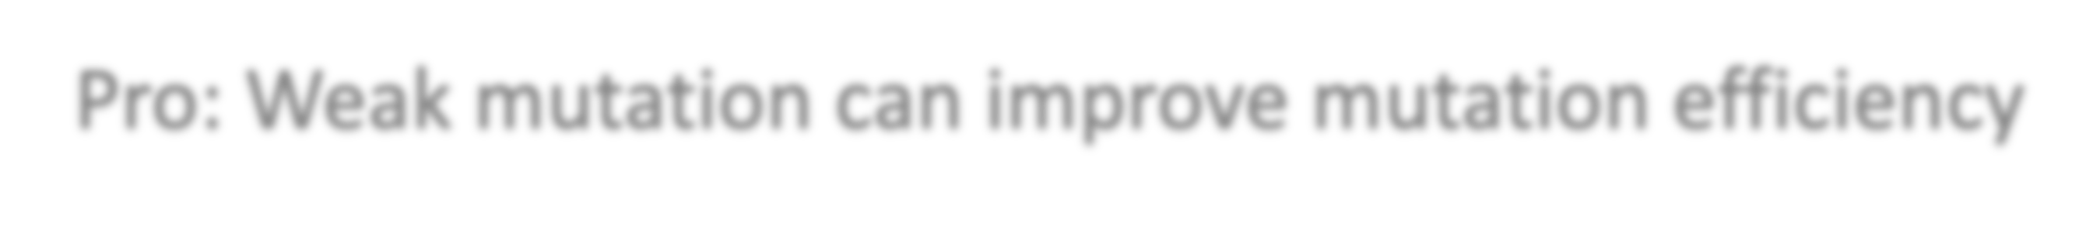
Weak mutation
t1: a=1, b=0
read a, b a=a+b x=2*b return x
read a, b a=a-b x=2*b return x
Internal state:
a-b=a+b=1
mutation
P
m1
unkilled
Pro: Weak mutation can improve mutation efficiency

Slide 21
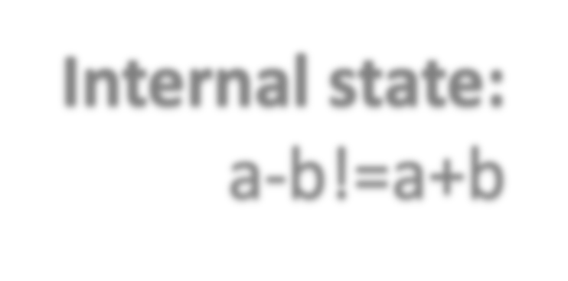



Weak mutation
t1: a=1, b=1
read a, b a=a+b x=2*b return x
read a, b a=a-b x=2*b return x
Internal state:
a-b!=a+b
mutation
P
m1
killed
Con: Weak mutation can cause imprecision

Slide 22
Do faster
Mutant compilation
DeMillo et al. [DeMillo+91] extended a compiler to compile all mutants at once to reduce the cost of generating and compiling a large number of mutants
Untch et al. [Untch+93] proposed the schema-based mutation approach, which generates one meta-mutant that encodes all the mutants and can be compiled by a traditional compiler
Mutant execution
Use parallel execution to speedup mutation testing

Slide 23
Meta-mutant
read a, b, m a=b if(m==0)
x=a+b if(m==1)
x=a-b if(m==2)
x=a*b
… print x
m=0: P
m=1: m1 m=2: m2
…
read a, b a=b x=a+b print x
Schema-based mutation testing
P
Meta-Mutant

Slide 24
In-class exercise
What three factors are necessary (i.e., what needs to happen) to kill a mutant?
Can you name at least 5 mutation operators?
What is the difference between live, killed, equivalent and non-equivalent mutant?

Slide 25
Kill a Mutant
Reachability
Execute the mutated statement
Necessity
Make a program internal state change
Sufficiency
Propagate the change to output

Slide 26
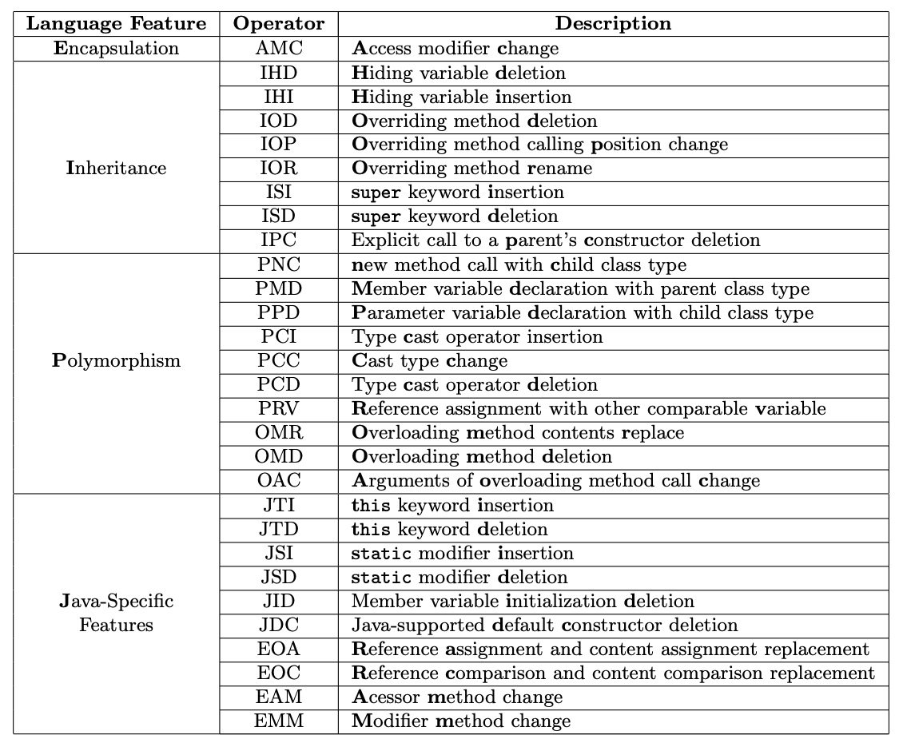
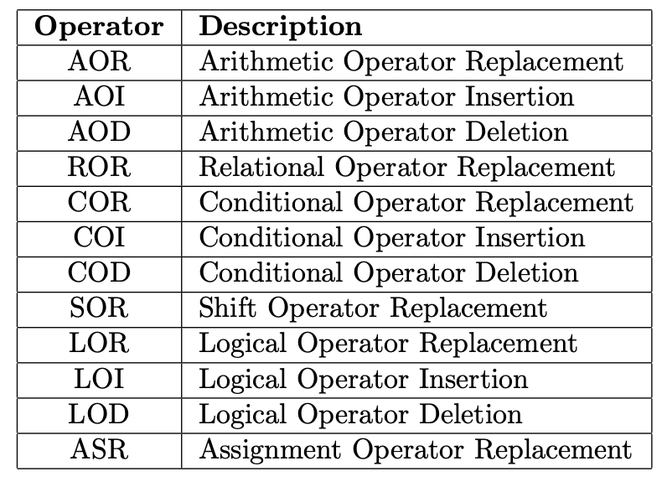
Java Mutation Operators (the MuJava tool)

Slide 27
Types of Mutants: definitions
A mutant M of program P is considered killed (or distinguished) by a test t in test suite T, iff:
P(t)!=M(t)
P(t) and M(t) denote, respectively, the test outputs of P and M when executed on test t.
A mutant M is considered to be equivalent mutant, iff
P(t)=M(t) for any t

Slide 28
This class
Mutation Testing
Basic idea
Detailed Approach
Limitation and solutions
Do fewer
Do faster
Do smarter
State of the art tools

Slide 29
Mutation testing tools
Java
PIT: http://pitest.org/
MAJOR: http://mutation-testing.org/
Javalanche: https://github.com/david-schuler/javalanche/
MuJava: http://cs.gmu.edu/~offutt/mujava/
C
MILU: http://www0.cs.ucl.ac.uk/staff/y.jia/Milu/
Python
MutPy: https://pypi.python.org/pypi/MutPy/0.4.0
C#
NinjaTurtles: http://ninjaturtles.codeplex.com/
53

Slide 30
Mutation testing applications
Simulating real bugs for test evaluation
Mutation-based test generation
Mutation-based regression testing
Mutation-based fault localization
Mutation-based program repair
…

Slide 31
Agenda
Quiz 9
Questions for Assignment 6
https://cs.gmu.edu/~winglam/classes/637/assigns/assign06.html
Assignment 6 is due tonight BEFORE 11:59PM
Go over optional take-home final
https://cs.gmu.edu/~winglam/classes/637/final/take-home-final.html
If you are concerned about your grades, I highly encourage you to spend time on the optional take-home final
Wrap up lecture on Chapter 9.1.2 Mutation Testing
15min break
Play CodeDefenders
https://code-defenders.org
Pass back quiz retakes
NO class next week -- Enjoy your Fall break!

Slide 32
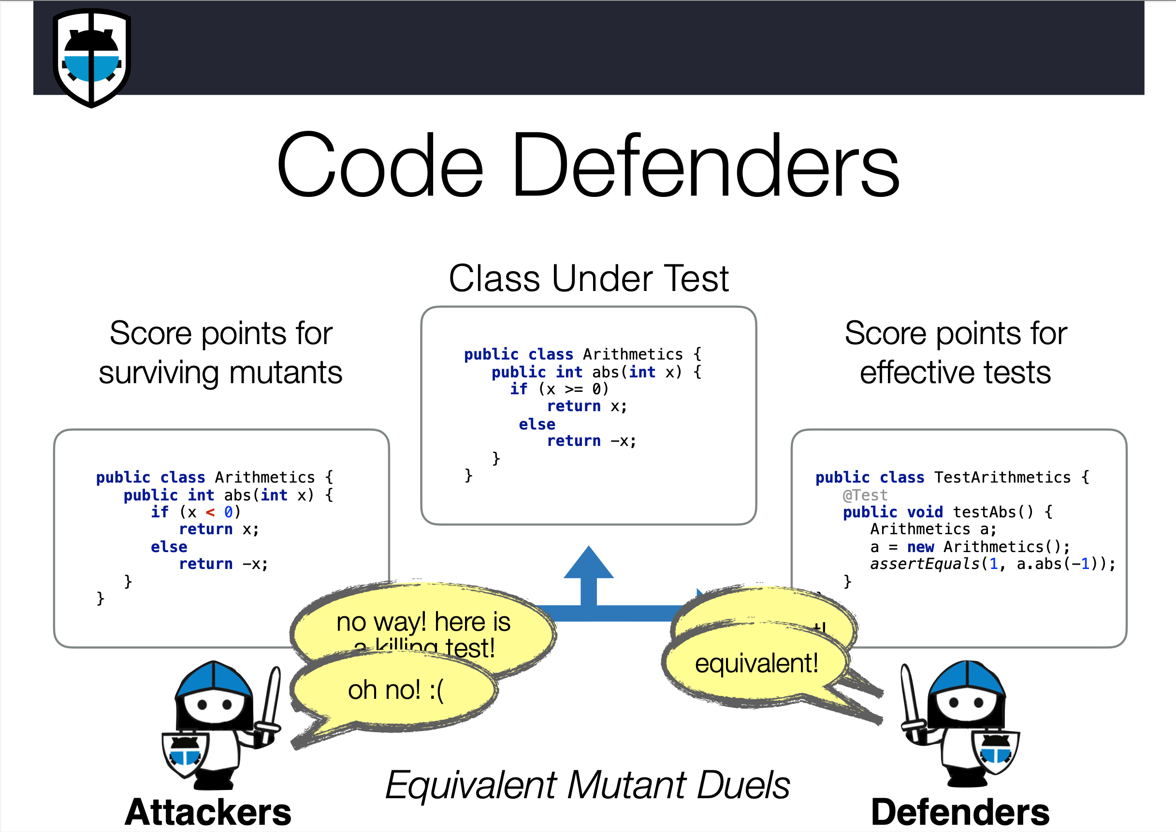

Slide 34
Techniques To Help Android Testing
Two popular types of techniques are
Record and replay techniques and
Automated-input-generation (AIG) techniques.
R&R tools allow for the recording of touchscreen and system events to support testing tasks, such as crowd-sourced testing and regression testing
AIG tools generate touch or system-based inputs to maximize certain test criterion, such as code coverage, or discovering crashes

Slide 35
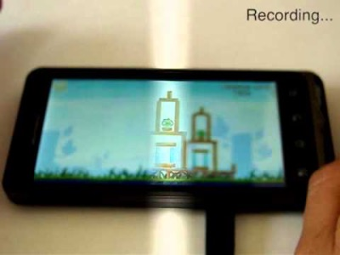
Example of R&R tool
RERAN is a R&R tool for Android
At a high level, it captures inputs sent from the phone to OS, and allows the sequence of events to be sent to the phone programmatically
RERAN can be used by developers and researchers for software debugging, testing, and maintenance

Slide 36





Automated UI Testing For Android Apps
Automatically explore the app through UIs, just like human users
Code coverage # of crashes
Capturing of screen content
…
Test effectiveness report
Test
Action(s) (screen tap, key press, ..)
Test tool
Test record and report
device
Little human effort
Scalable with numerous devices
Deeper functionality saturation
1

Slide 37

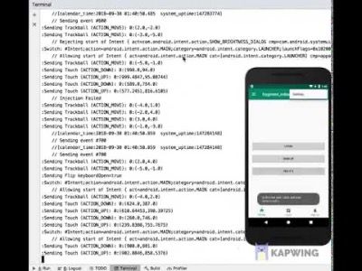
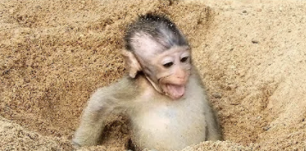
Frequently used Android testing tool -- Monkey
Monkey, a randomized UI input generator, is one of the earliest tools for testing apps
However, Monkey is simple and can get stuck
Notes:
https://medium.com/@shubhapatnim86/monkey-a-application-stree-testing-debugging-tools-for-android-mobile-developers-8191d8aa00c0

Slide 38
In-class exercise
Two popular types of techniques developed are
Record and replay techniques and
Automated-input-generation techniques.
R&R techniques allow for the recording of touchscreen and system events to support testing tasks, such as crowd-sourced testing and regression testing. AIG tools generate touch or system-based inputs to maximize certain test criterion, such as code coverage, or discovering crashes
Questions:
What are some challenges that you can think of that developers face when testing industrial mobile apps?
How helpful or unhelpful are the aforementioned two types of techniques to the challenges you identified?

Slide 39
Challenges on Testing Industrial Mobile Apps
Challenges from applicability :
Requiring app’s source code
Compatibility of testing tool (e.g., OS specific)
Challenges from scalability:
Scalability on testing apps with large codebases
Industrial-strength Android app can cause 64K reference limit exception during instrumentation

Slide 40

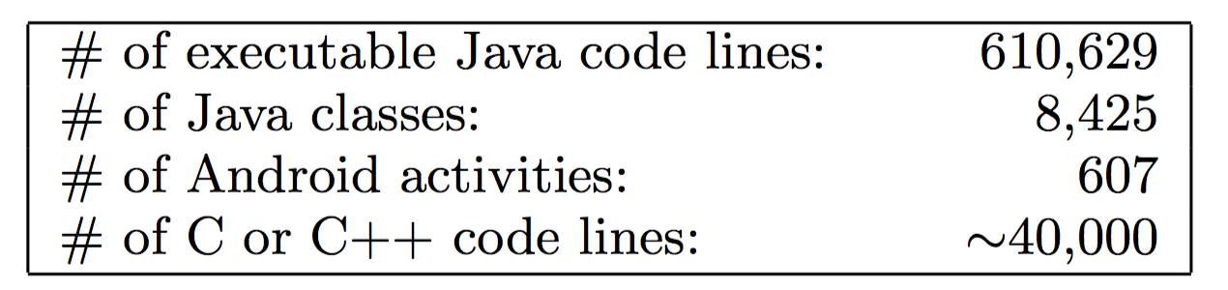
Real Real-World App - WeChat
WeChat = WhatsApp + Facebook + Instagram + PayPal + Uber …
1+ billion monthly active users
Daily number: dozens of billion messages sent, hundreds of million photos uploaded, hundreds of million payment transactions executed
WeChat backend: 2K+ microservices running on 40k+ servers
10M QPS during Chinese New Year Eve
Large codebase on WeChat Android

Slide 41
Outline
Goal: investigate how testing tools address challenges of testing industrial apps
Android test generation tools
results from applying Monkey to WeChat
techniques to address Monkey’s limitations
optimizations to techniques
results from categorization and coverage analysis of not-covered activities
Android record-and-replay tools
qualitative study of tools
quantitative study of tools for industrial apps

Slide 42
Results from applying Monkey to WeChat

Slide 43
Monkey - Experimental setup
Experiment Setup
Set Monkey to fire random events every 500 milliseconds
Run Monkey on WeChat 5 times independently
Run Monkey for 18 hours each time (2 hours without login)
Evaluation Metric
Line coverage
Activity coverage

Slide 44
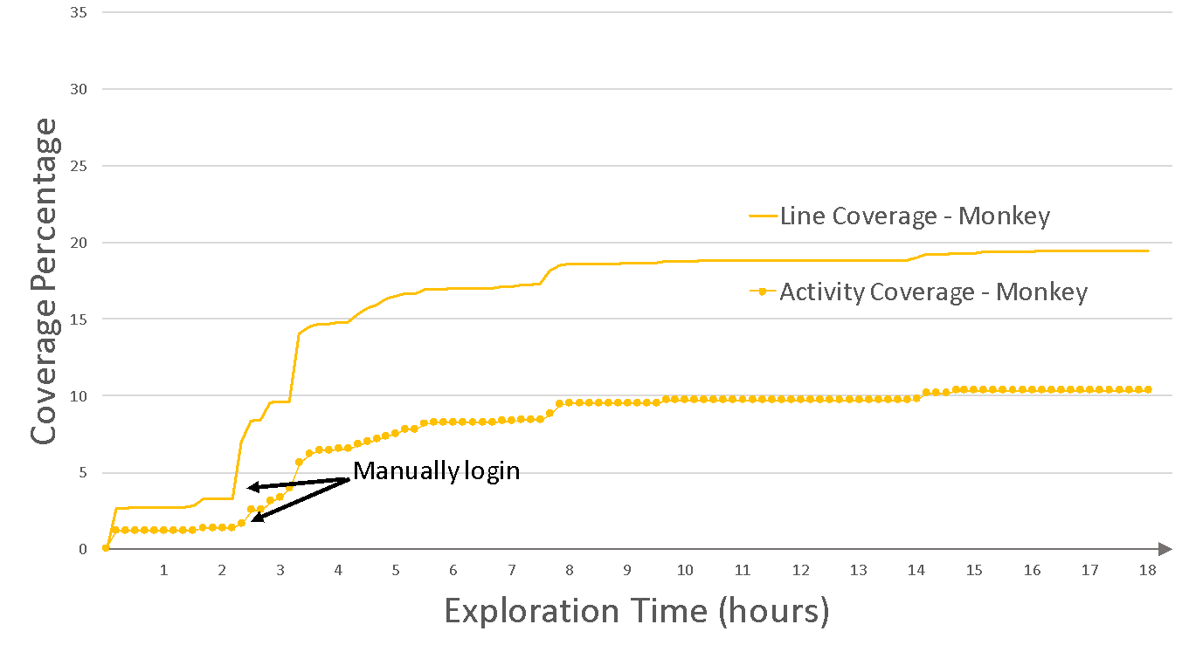
Monkey - Coverage result findings
Finding 1: Monkey has low line coverage (19.5%) and low activity coverage (10.3%)
Finding 2: Monkey allocates a lopsided distribution of exploration time on each activity

Slide 45
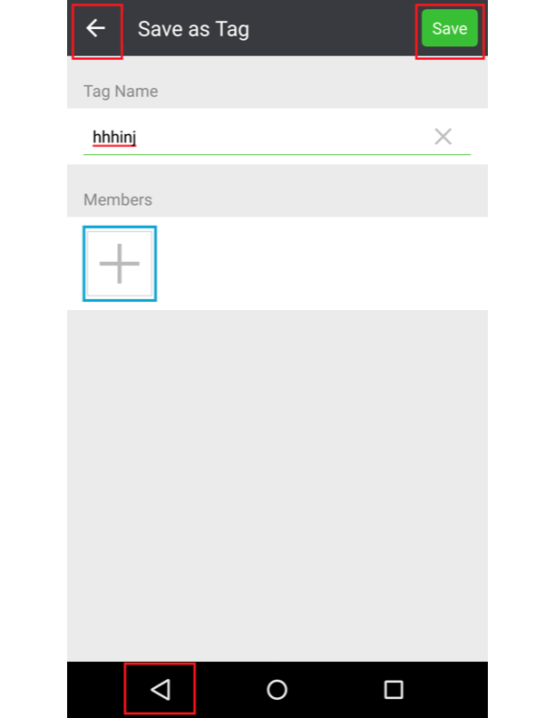
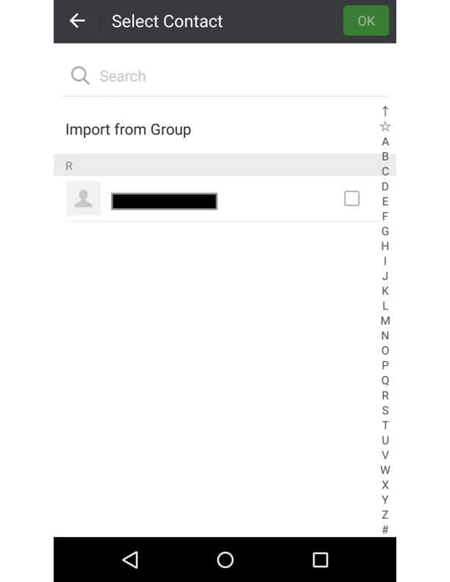
Monkey - Exploration time challenges
Widget obliviousness: It is difficult to generate events at the small-sized GUI element
State obliviousness: Monkey explores the same two activities repeatedly without contributing to new code coverage
Back to other activities.
To another activity
SelectContactUI
ContactLabelUI

Slide 46
In-class exercise
Limitations:
Widget obliviousness: It is difficult to generate events at the small-sized GUI element
State obliviousness: Monkey explores the same two activities repeatedly without contributing to new code coverage
Questions:
How would you improve a random test-input-generation tool like Monkey to address the limitations above?
Knowing what you know about generating inputs for testing, besides randomly generating inputs, how would design a new test generation tool?

Slide 47
Techniques to address Monkey’s limitations

Slide 48
New Approach
Design goals
Have direct access to UI elements on activity under test
Allocate more exploration time towards new GUI states
Techniques
Use UIAutomator framework to gain UI layout tree
Abstract GUI states to guide firing of state-changing events

Slide 49
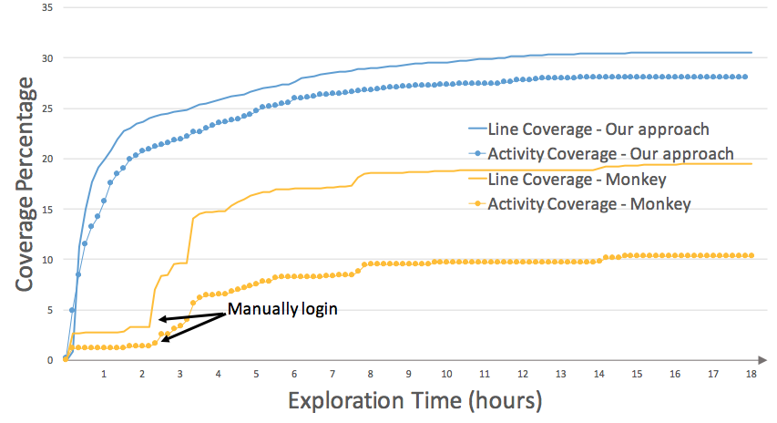
New Approach - Coverage result
New approach covers an additional 11.1% p.p. more lines and 18.4% p.p. more activities than Monkey does!

Slide 50
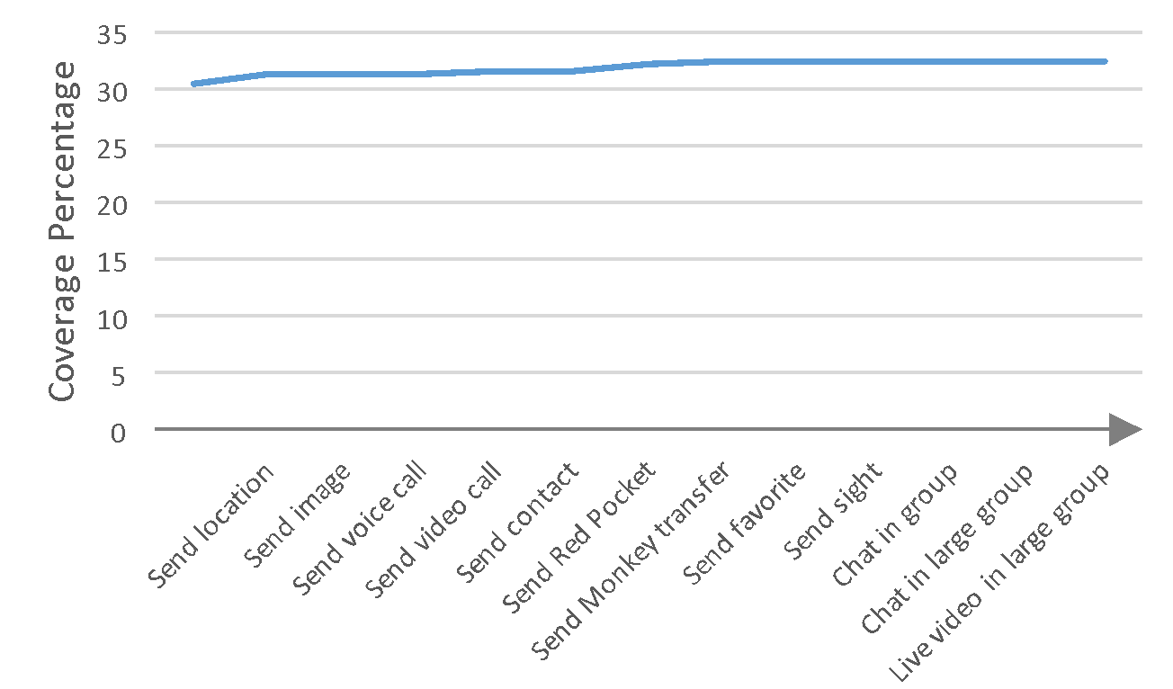
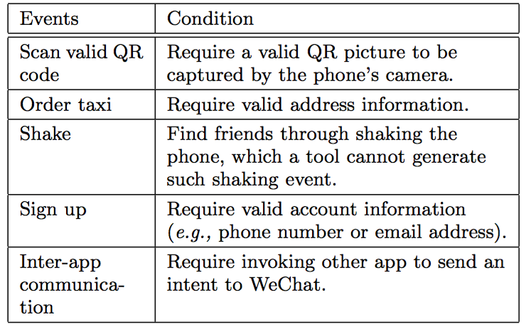
Human Intervention
Provide client-to-client interaction
Line coverage increases 1.9% p.p.
Activity coverage increases 0.6% p.p.
Provide additional app events
Line coverage increases 0.8% p.p.
Activity coverage increases 0.8% p.p.
Human intervention doesn’t help much

Slide 51
Optimizations to our approach

Slide 52
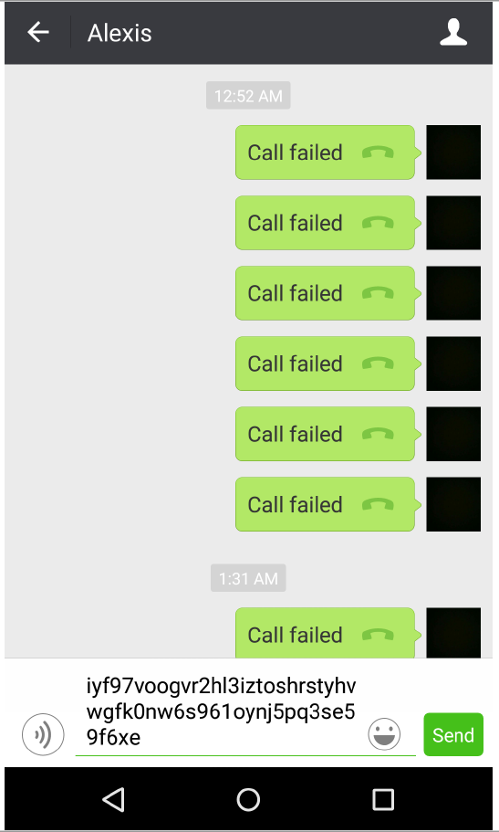
Optimization - Repetition-Avoidance Technique
Previous approach explores newly generated states for a long time without coverage increment
Optimization: allow developers to specify what buttons should not be clicked at a given GUI state

Slide 53
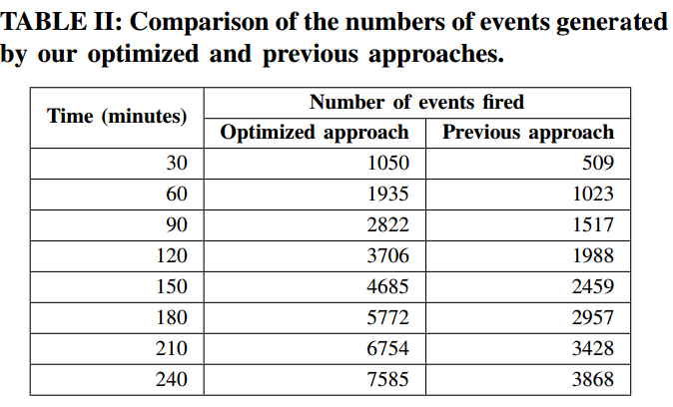
Optimization - Firing-Speedup Technique
Reduce the runtime cost of picking GUI widgets and firing events
Optimization: Fire events onto widgets via Android Debug Bridge instead of the UI Automator

Slide 54
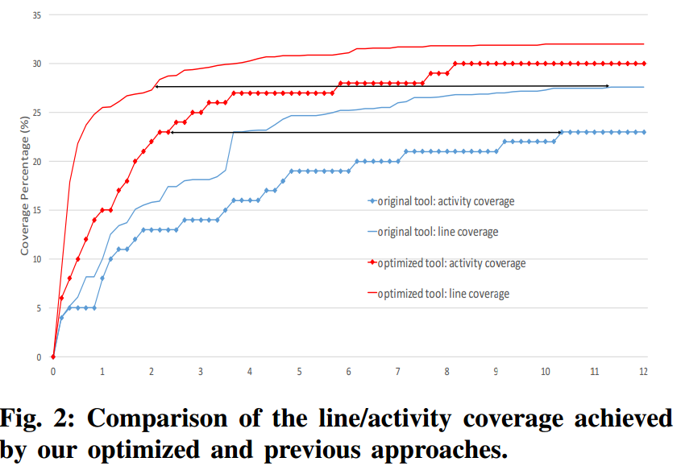
Coverage Result
Line coverage increases 6.0% percentage points
Activity coverage increases 6.0% percentage points
Optimized approach needs 2 vs. 12 hours of original approach to achieve same coverage!

Slide 55
Categorization and coverage analysis of not-covered activities

Slide 56
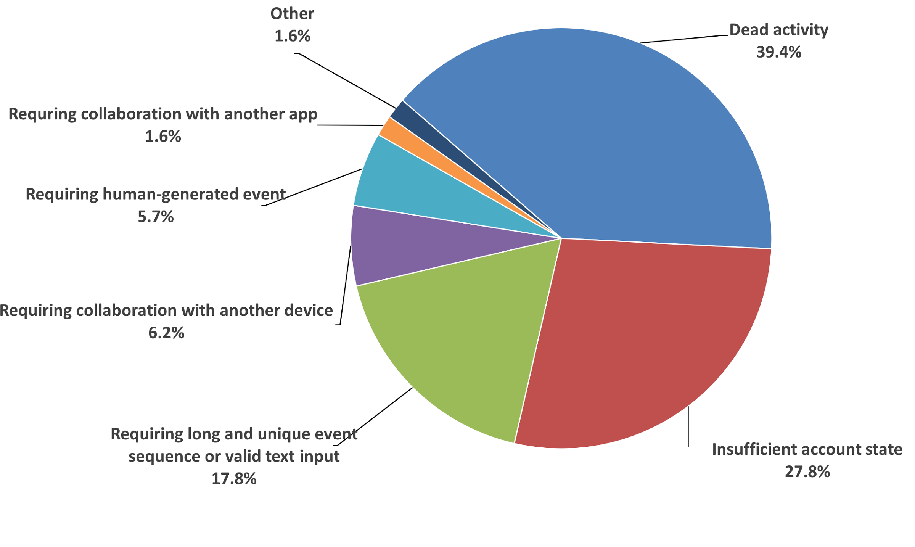
Root Causes of Not-covered Activities
Manually investigate source code of not-covered activities
Categorize not-covered activities into 7 major categories & 12 minor categories based on the conditions needed to trigger these activities

Slide 57
In-class exercise
Why do you think dead activities exist in apps like WeChat?
Pick some of the other not-covered type of activities – how would you improve automated tools to be able to cover such activities?

Slide 58
Categorization - Dead Activities
Activities not possible to be covered by most users and our testing tool
Legacy implementations: a new implementation of the same feature has been deployed while the old implementation continues to reside in WeChat
Unreleased features: certain features in WeChat that are not yet released to the public and are disabled
39.4% (173 out of 439) of the not-covered activities are in the category of Dead Activities

Slide 59
Categorization - Insufficient Initial Account States
These activities require a special account state to be available
Requiring financial information: need a testing account with at least one bank card with a non-zero balance
Requiring account-history content: a Chinese account has different features compared to an oversea account
Requiring enabled feature: not all features are enabled by default
27.8% (122 out of 439) of the not-covered activities are in the category of Insufficient Initial Account States

Slide 60
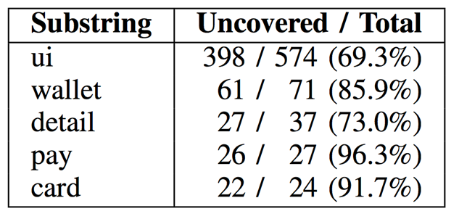
Coverage Analysis - Substring Hole Analysis
To identify commonalities of not-covered activities
Substring hole: name set of not-covered activities
Split not-covered activity names (by capitalized chars) into keywords and then count the occurrences of the keywords
We find lots of “wallet”-related activities to be not-covered
Developer spent 48 hours to test wallet activites -> substring hole of “wallet” reduced to 22.5% (16 / 71)!

Slide 61
Coverage Analysis - Critical-Activity Analysis
Use activity transition graph (ATG) with coverage information to locate bottlenecks of app exploration:
node: an Android activity; edge: an event
Critical activity: a not-covered activity being the only predecessor of some other not-covered activities in the ATG
Result
We locate 20 critical activities with 84 unique immediate successors (i.e., not-covered activities)
11,153 out of 19,531 events leading from a covered activity to the critical activities are onActivityResult events (end of some activity)

Slide 62
Summary
First industrial case study of applying Monkey on WeChat
Empirical findings on Monkey’s limitations in an industrial setting
New techniques that addresses the major limitations of Monkey and accomplished substantial code-coverage improvements
Optimization techniques to improve the effectiveness and efficiency of automatic random testing tools for Android
Manual categorization of not-covered activities and coverage analysis to provide insightful information about not-covered activities

Slide 63
Outline
Goal: findings and techniques for how testing tools address challenges of testing industrial apps
Android test generation tools
results from applying Monkey to WeChat
techniques to address Monkey’s limitations
optimizations to techniques
results from categorization and coverage analysis of not-covered activities
Android record-and-replay tools
qualitative study of tools
quantitative study of tools for industrial apps

Slide 64
Android Testing Tools
Tools like Monkey₁ exist to help developers automatically test their app
Record and replay tools help developers test specific use cases:
Regression testing on two different versions of the app
Compatibility testing on a version of the app but on different devices
Performance testing on a version of the app many times
Are the existing record and replay tools good enough in practice?
1: https://developer.android.com/studio/test/monkey.html

Slide 65
In-class exercise
Record and replay tools help developers test specific use cases:
Regression testing on two different versions of the app
Compatibility testing on a version of the app but on different devices
Performance testing on a version of the app many times
Question:
For record and replay tools, what are some characteristics that you believe are important to developers?
How many of these characteristics do you think readily available record and replay tools of Android have?

Slide 66
Our Work
Qualitative study of popular record-and-replay tools
Quantitative study of selected record-and-replay tools based on three main aspects:
Ability to reproduce common usage scenarios
on the same device
on different devices
Space overhead

Slide 67
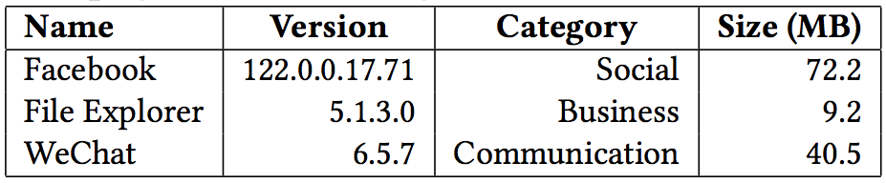
Selected Apps
Selection based on their popularity and category

Slide 68
In-class exercise
What do you think the following characteristics are about? Which ones are more important than others?
Characteristics:
coordinate sensitive
widget sensitive
state sensitive
timing sensitive
custom OS
access to the source code of the app under test
instrumenting the app
rooting the device
open sourced

Slide 69
Desirable Characteristics
Five highly desirable characteristics:
coordinate sensitive
widget sensitive
state sensitive
timing sensitive
custom OS
Four secondary characteristics:
access to the source code of the app under test
instrumenting the app
rooting the device
open sourced

Slide 70
Coordinate Sensitive
Events are recorded based on the coordinates of the actions on the GUI screen
Example trace:
TOUCH|{'x':513,'y':1692,'type':'downAndUp',}
Image from http://tekeye.biz/wp-content/uploads/2013/03/android_coordinate_system.png

Slide 71
Widget Sensitive
Events are recorded based on the widgets (e.g., buttons, text fields) that the actions interacted with
Example trace:
TOUCH|{'id':’R.id.loginButton','type':'downAndUp'}
Image from https://www.tutorialspoint.com/android/images/ui_control.jpg

Slide 72
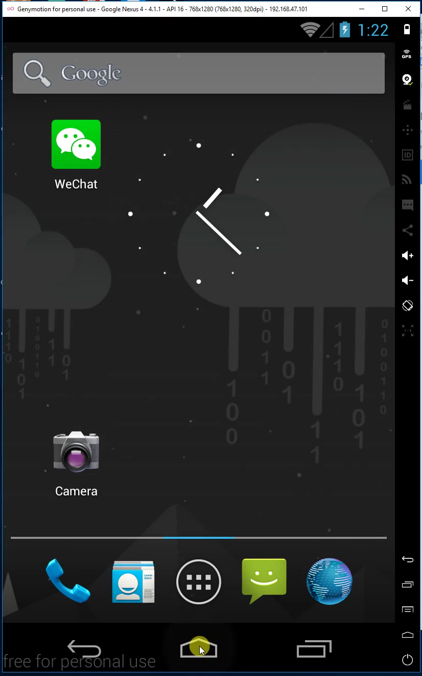
State Sensitive
Tool can be replayed successfully only if the device’s state is same as when it was recorded
Typical state-insensitive tools reset the app before record and replay

Slide 73
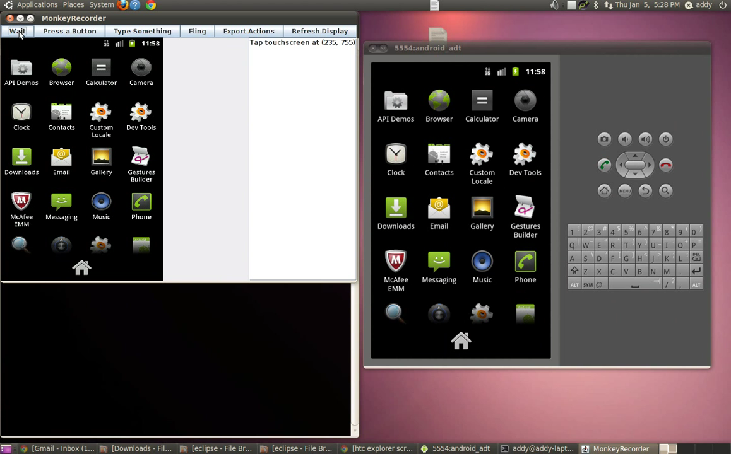
Timing Sensitive
Tool automatically sets the timing between recorded events
Example trace:
WAIT|{'seconds':2.0,}
Gif from https://www.youtube.com/watch?v=X2otzqZvZ4M

Slide 74
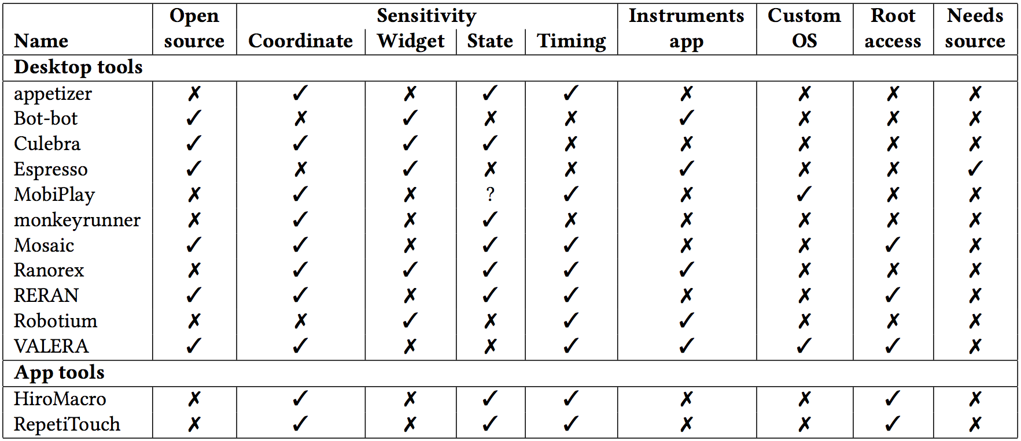
Characteristics of Each Tool
* - Desirable characteristics
*
*
*
*
*

Slide 75
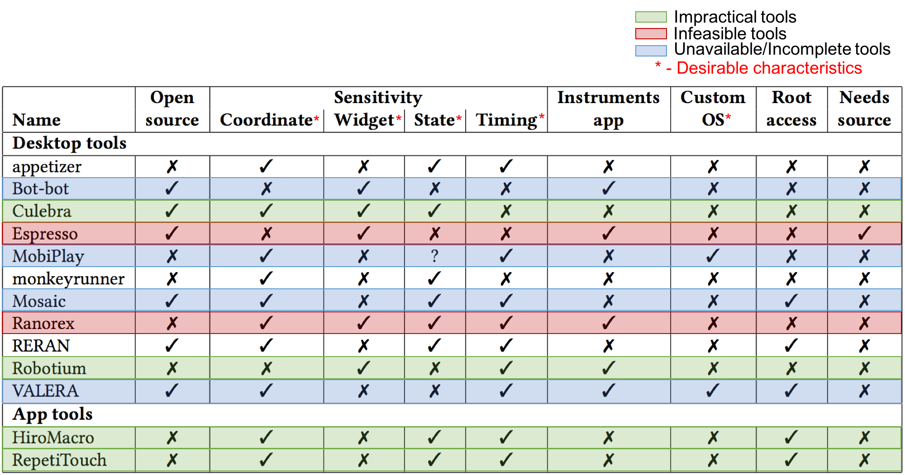
Inapplicable Tools
There exist many record-and-replay tools, but few are available for developers to actually use in practice
Unfortunately, none of the tools that we find exhibit all of the desirable characteristics

Slide 76
Our Work
Qualitative study of popular record-and-replay tools
Quantitative study of selected record-and-replay tools based on three main aspects:
Ability to reproduce common usage scenarios
on the same device
on different devices
Space overhead

Slide 77
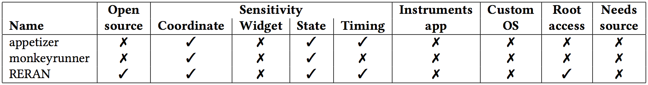
Selected Tools and Apps
Tools:
Apps:
* - Desirable characteristics
*
*
*
*
*

Slide 78
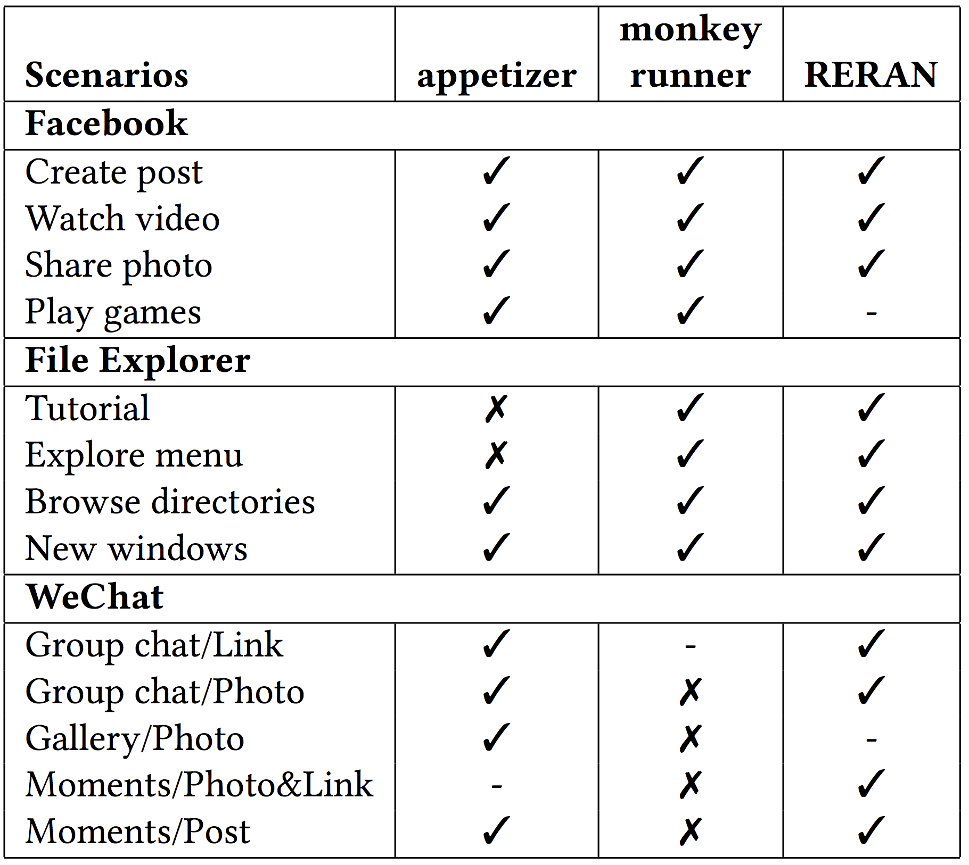
Reproducing Common Usage Scenarios
RERAN is the only tool able to record and replay all scenarios
“-” : the tool produces unstable results

Slide 79
Replaying Robustness
Recorded traces from common usage scenarios replayed on different-resolution devices
All three tools performed differently; Appetizer did best but still fails because it cannot support dragging events
None of these tools are able to replay complicated scenarios on different screen sizes successfully

Slide 80
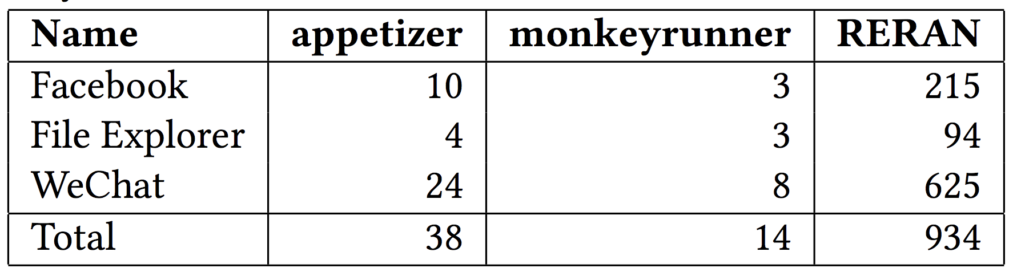
Space Overhead (trace size in kB)
Traces produced by RERAN occupy about 67 times the space that traces from monkeyrunner occupy
Effectiveness of RERAN comes at the cost of space overhead
* Size is in kB
* Size is in kB

Slide 81
Summary
Qualitative study of popular record-and-replay tools for Android apps
Quantitative study of selected record-and-replay tools for three popular industrial Android apps
Study results highlighting strengths and weaknesses of tools and identifying future tool-research directions

Slide 82
Agenda
Quiz 9
Questions for Assignment 6
https://cs.gmu.edu/~winglam/classes/637/assigns/assign06.html
Assignment 6 is due tonight BEFORE 11:59PM
Go over optional take-home final
https://cs.gmu.edu/~winglam/classes/637/final/take-home-final.html
If you are concerned about your grades, I highly encourage you to spend time on the optional take-home final
Wrap up lecture on Chapter 9.1.2 Mutation Testing
15min break
Play CodeDefenders
https://code-defenders.org
Pass back quiz retakes
NO class next week -- Enjoy your Fall break!

